Slide 1
Sabot Separation Empirical Modelling
JD Leaverton
April 2021

Slide 2
Undergraduate Thesis: Simulating hypervelocity sabot separation
Purpose
Accurately predicting degree of separation increases testing effectiveness
Simulation software allows for new sabot package designs for different projectile geometries
Phase I: Empirical modelling to test simulation results
Data collected from HVI tests
Relates degree of separation (separation radius) to flight parameters
Phase II: Development of sabot flight simulation script
Uses newtonian impact theory for hypersonic flow
Numerically integrates over projectile flight to find degree of separation

Slide 3
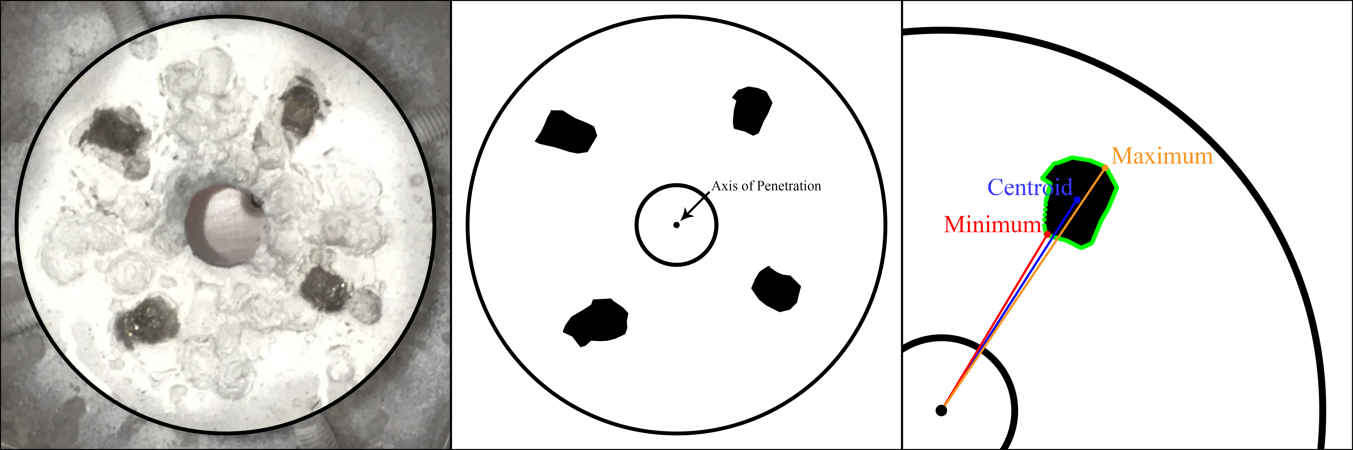
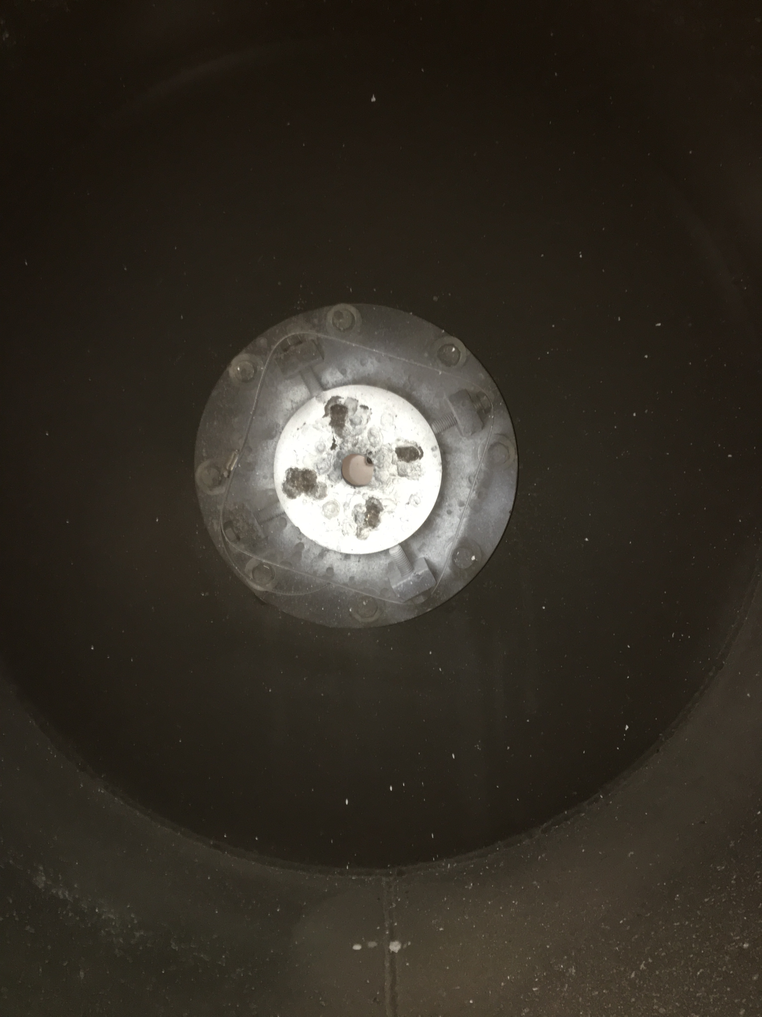
Phase I: Data Collection
Data Overview
N = 35
52% of available tests sampled during collection
Centroid measurements were used for empirical models
Sabot petal impact photography normal to the stripper plate
Image processing using Adobe Photoshop and Python scripts to convert image data to the degree of separation

Slide 4
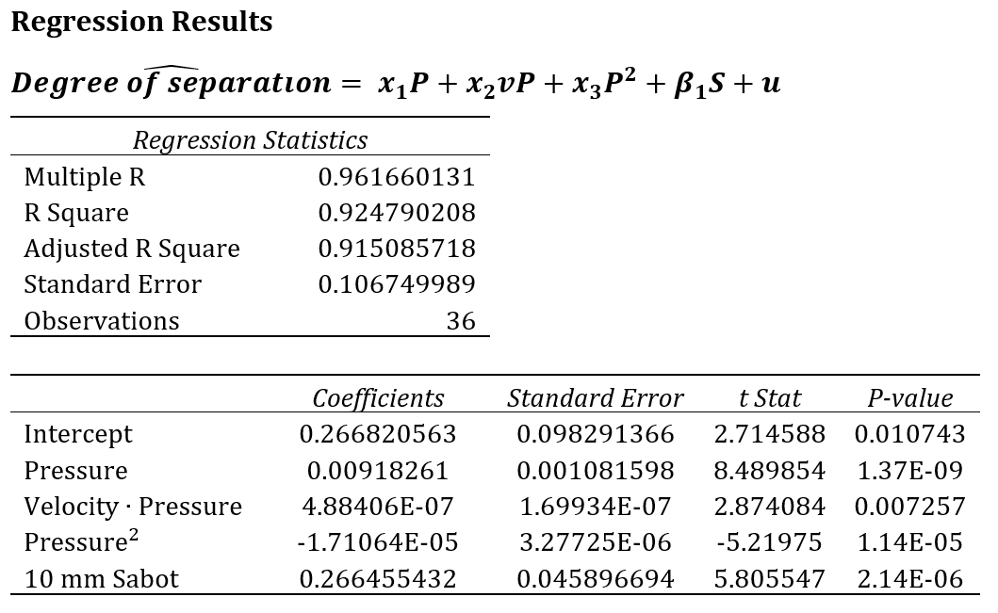
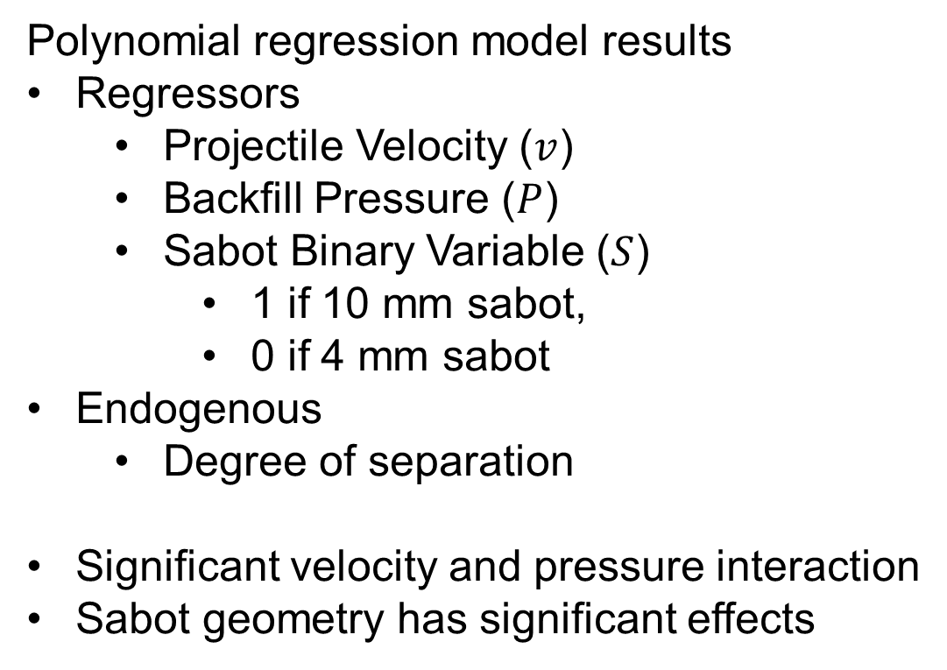
Phase I: Empirical regression model
Polynomial regression model results
Regressors
Projectile Velocity ($v$)
Backfill Pressure ($P$)
Sabot Binary Variable ($S$)
1 if 10 mm sabot,
0 if 4 mm sabot
Endogenous
Degree of separation
Significant velocity and pressure interaction
Sabot geometry has significant effects

Slide 5
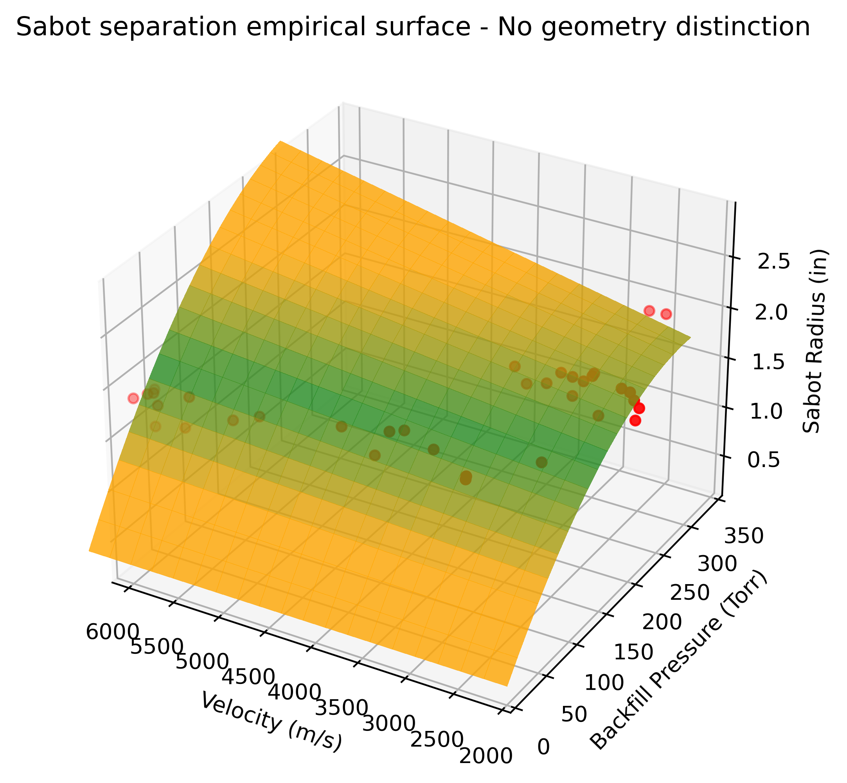
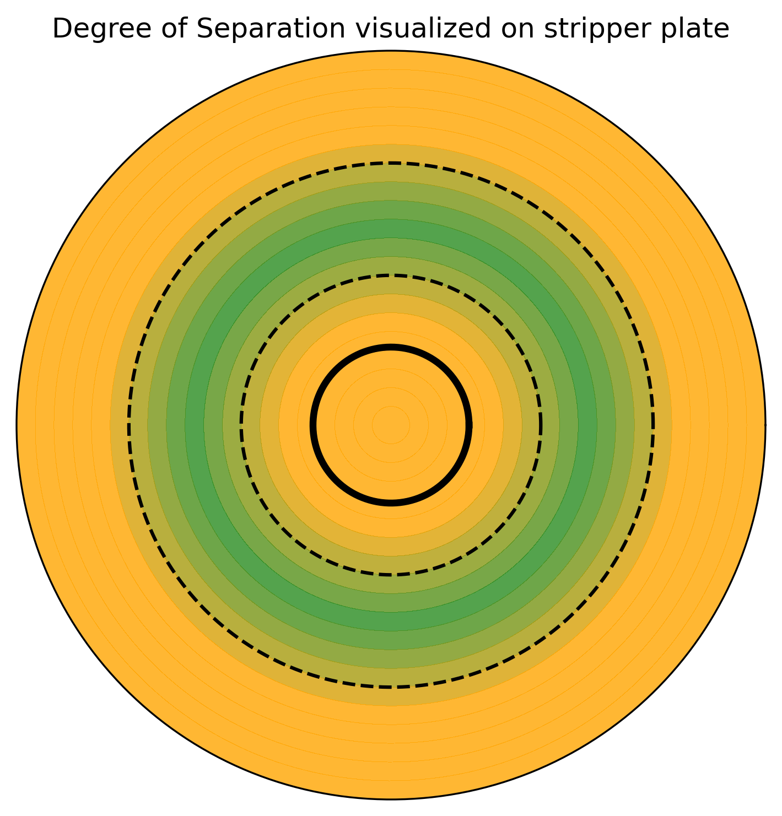
Phase I: Regression results

Slide 6
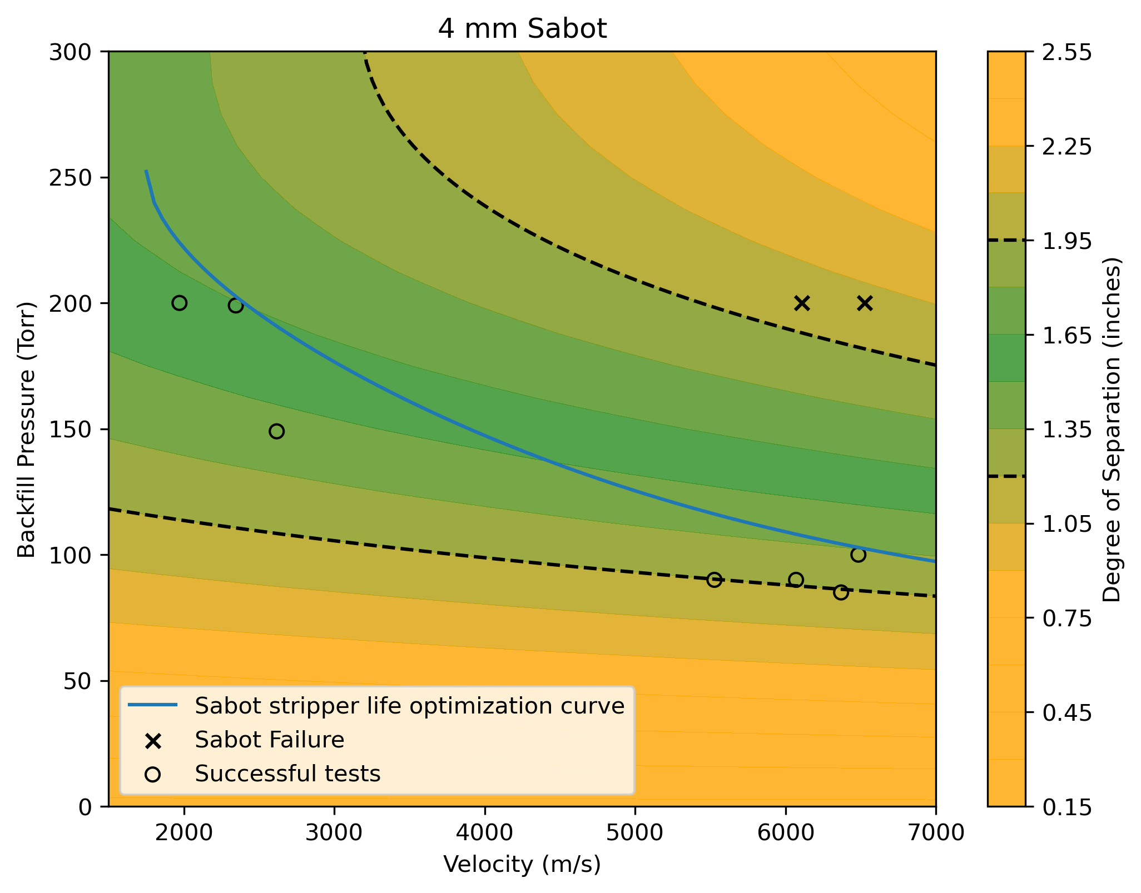
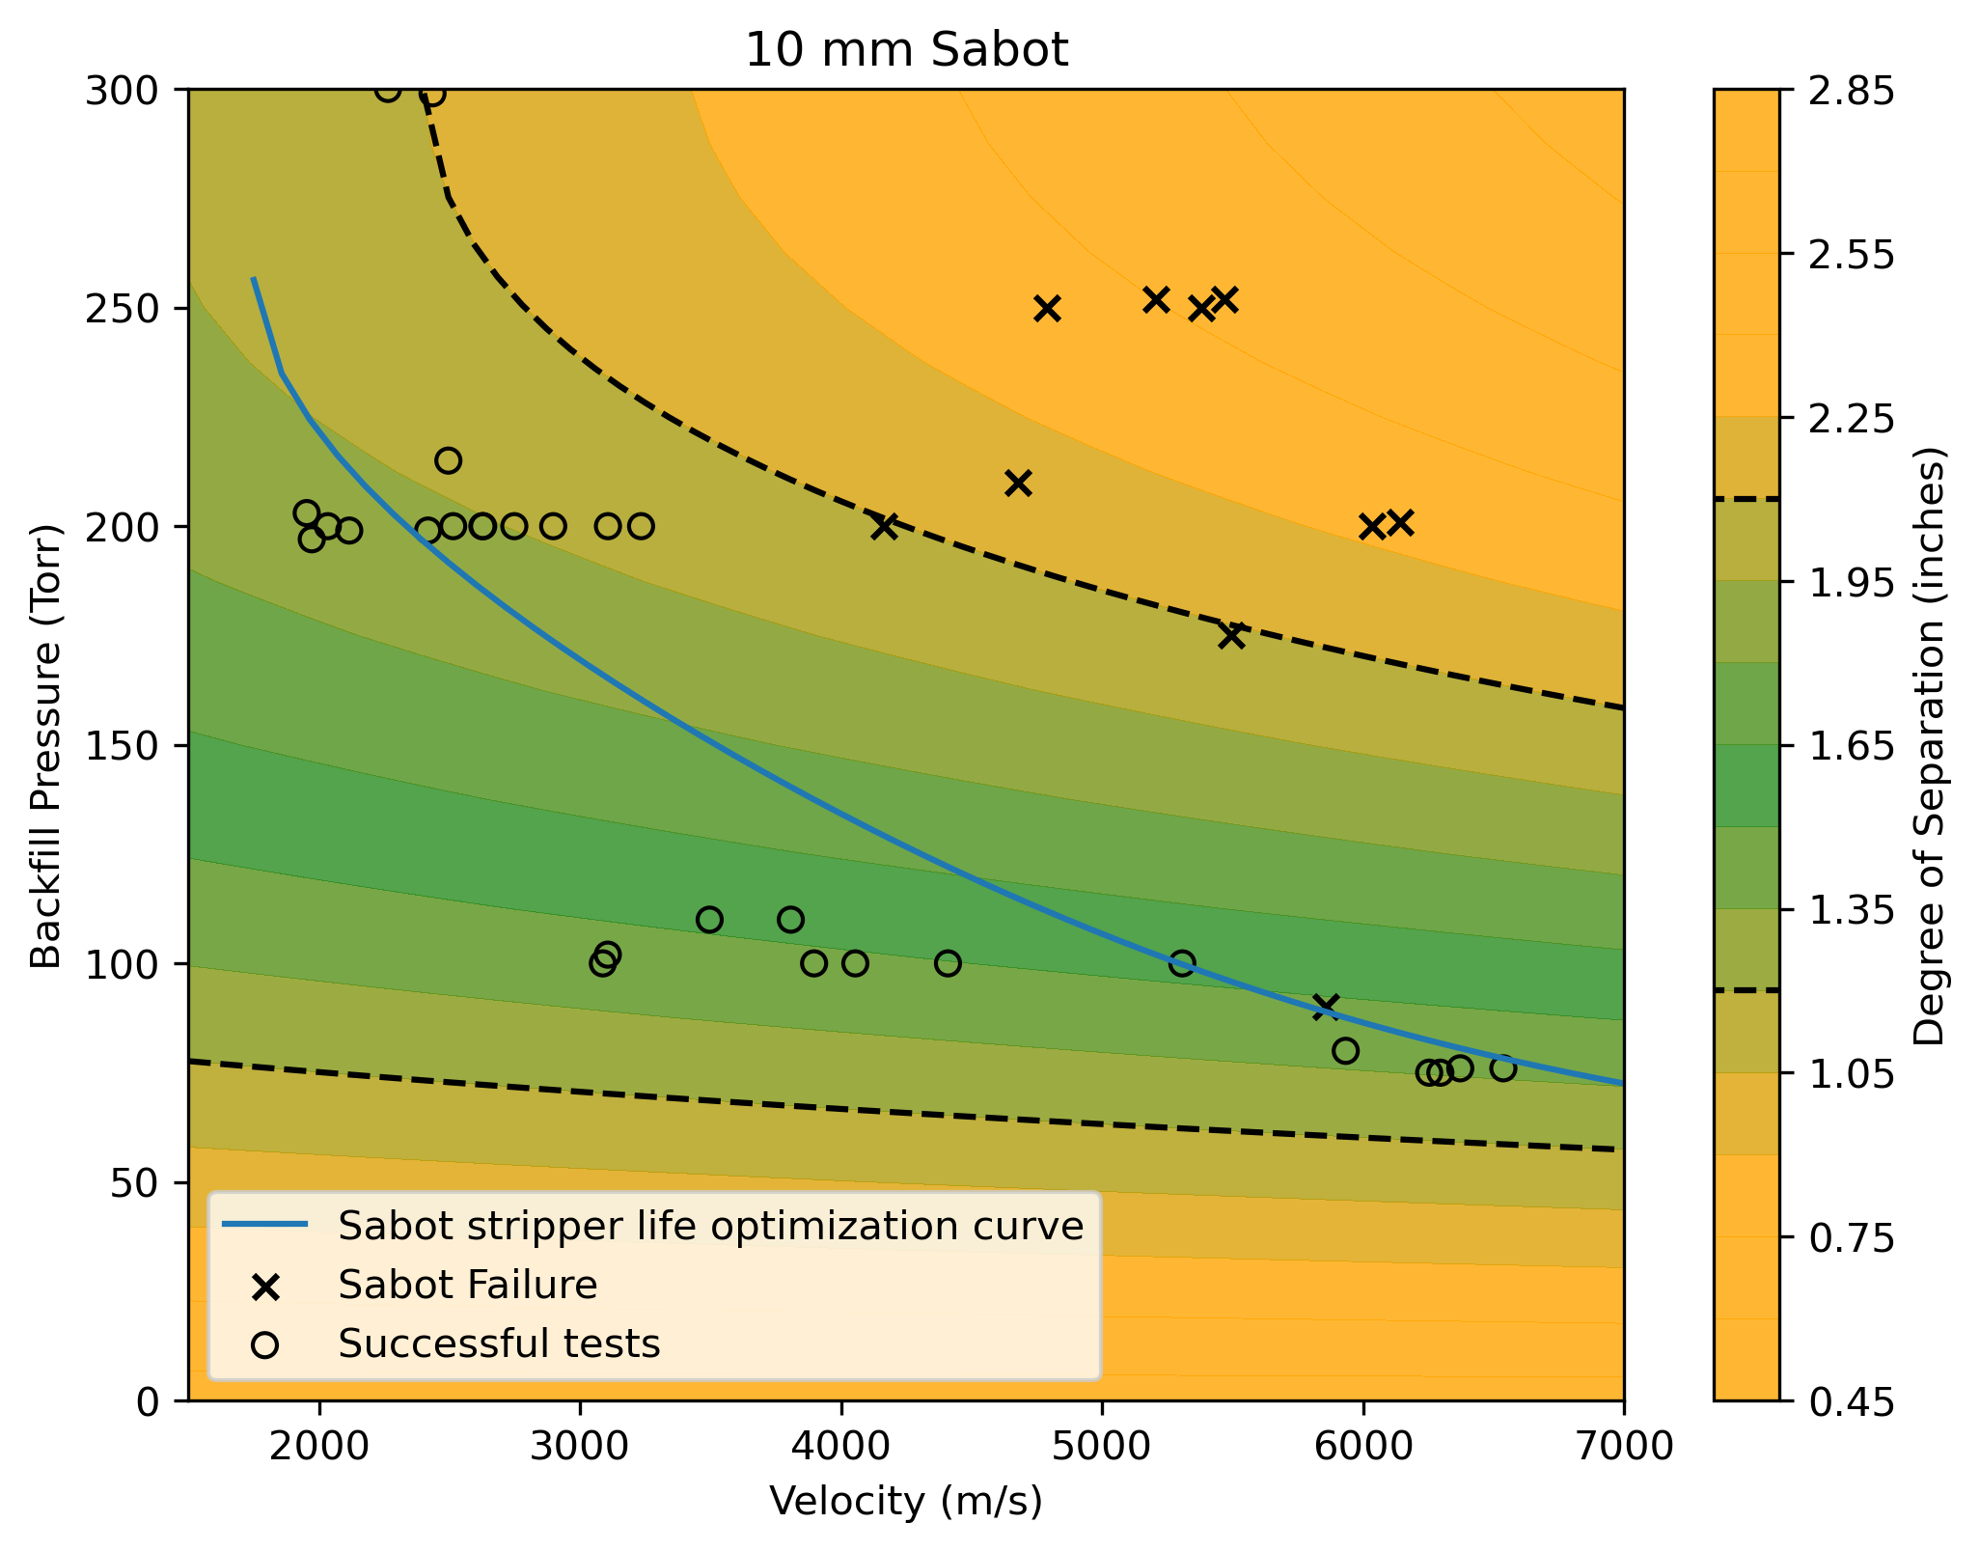
Phase I: Regression results

Slide 7
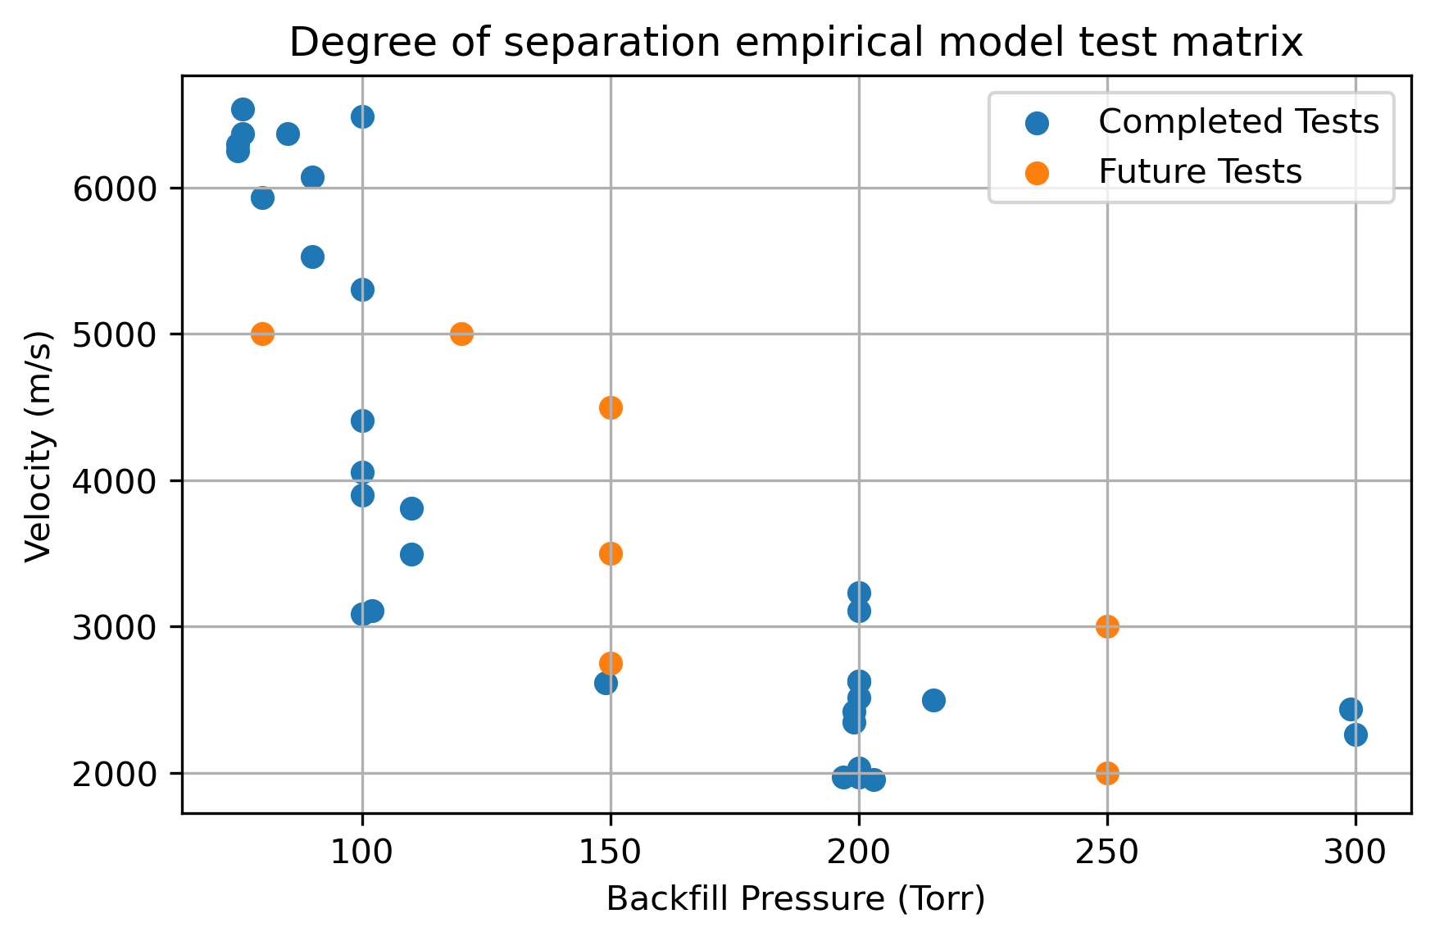
Future Work
Completing test matrix to improve model accuracy
Testing model’s accuracy with new data
Investigation of rotation about axis of penetration

Slide 8
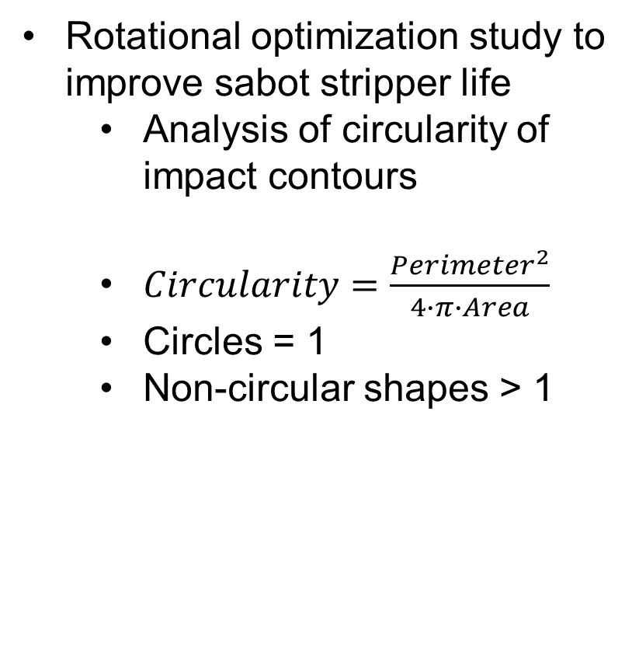
Future Work
Rotational optimization study to improve sabot stripper life
Analysis of circularity of impact contours
$Circularity=\frac{{Perimeter}^{2}}{4∙π∙Area}$
Circles = 1
Non-circular shapes > 1

Slide 9



April 15, 2021

